Slide 1
Teaching History of Pharmacy According to the AIHP Guidelines:
E. Growth of the Pharmaceutical Industry
Created by: Karen Nagel-Edwards,
PhD
Midwestern University Chicago College of Pharmacy
Reviewed by: Patricia Jusczak,
BS Pharm
University of Hawai'i at Hilo, The
Daniel K. Inouye College of Pharmacy
Developed by the Teaching History of Pharmacy Committee of the History of Pharmacy SIG, 2017-18
Picture: Pharmacist at People’s Drug Store No. 5, Washington, DC, c. 1920. Library of Congress Prints and Photographs, LC-USZ62-129891

Slide 2
Italy
Earliest European development of chemical industry
  1294 – Venice
  Venetian treacle was an important export
  Monasteries got involved in industrial pharmaceutical activity (Florence)
    Distilled waters
    Cosmetics

Slide 3
17th and 18th Century
The first pharmaceutical manufacturing in England began with The Society of the Art and Mystery of the Apothecaries of the City of London
  In 1623, the Society established a cooperative of apothecaries who agreed to produce Galenicals and chemicals on a large scale

Slide 4
17th and 18th Century
Robert Boyle (father of modern chemistry) and Ambrosius Gotfried Hanckwitz (Godfrey)
  Built chemist’s shop with laboratory in London
  Godfrey later transformed shop into world’s leading producer of phosphorus
  Also prepared several chemicals and Galenicals

Slide 5
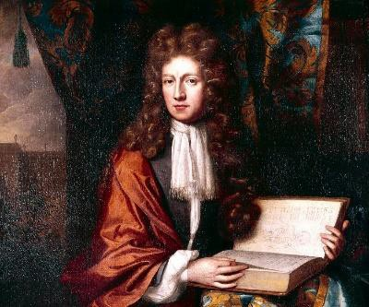
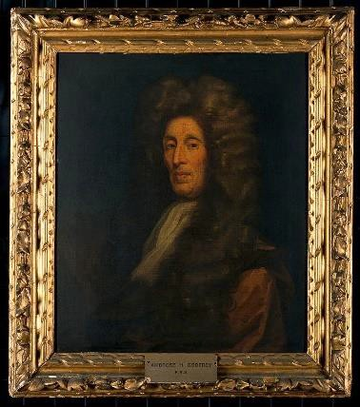
17th and 18th Century
Robert Boyle (father of modern chemistry) and Ambrosius Gotfried Hanckwitz (Godfrey)
  Built chemist’s shop with laboratory in London
  Godfrey later transformed shop into world’s leading producer of phosphorus
  Also prepared several chemicals and Galenicals

Slide 6
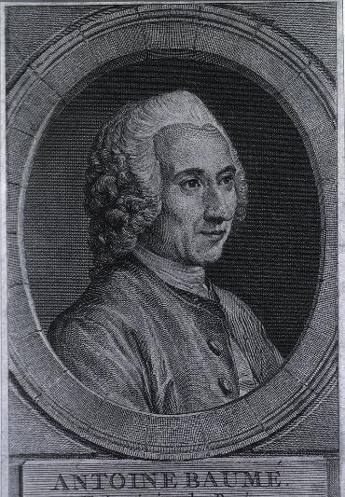
17th and 18th Century
Antoine Baume
  1728-1804
  French chemist and pharmacist
    One of first in France to manufacture chemicals and Galenicals in large scale
    Transformed his shop into a manufacturing plant
    Inventor of a number of technical improvements to laboratory equipment
    Over 2400 products on his 1775 price list

Slide 7
17th and 18th Century
1698: first drug patent
  Epsom salts (magnesium sulfate heptahydrate)

Slide 8
Revolutionary War Era
Continental Congress resolution (1775)
  Established an Army Hospital
  Staff included:
    Director-general and chief physician
    4 surgeons
    1 apothecary
    20 mates
Resolution reorganizing the medical department (1777)
  Apothecaries roles restricted to pharmaceutical ones

Slide 9
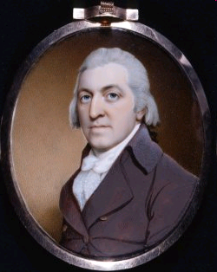
Andrew Craigie
  1754-1819
  Appointed Apothecary General of all US military districts during American Revolution
    Rank of Lieutenant Colonel
    Accompanied physicians to battle
    Apothecary job description separate and distinct from physician
http://www.buyorkney.com/roots/biographies/img/andrew_craigie_jr.jpg
Notes:
Appointment of Apothecary General at rank of Lieutenant Colonel was a first for pharmacy in America in that an apothecary was recognized as a commissioned officer.
This and clearly defined job description = 2 firsts in recognition of pharmacist as professionals.

Slide 10
Andrew Craigie
  Role as Apothecary General:
    Receive, prepare and deliver drugs (and instruments and shop furniture) to the army
    Created and supervised large-scale compounding / chemical warehouse, the Elaboratory, to fill and deliver medicine chests to military hospitals and battlefields
  Sets precedent for pharmacists to gain professional recognition
  After war, became Apothecary General of the US
Notes:
Appointment of Apothecary General at rank of Lieutenant Colonel was a first for pharmacy in America in that an apothecary was recognized as a commissioned officer.
This and clearly defined job description = 2 firsts in recognition of pharmacist as professionals.

Slide 11
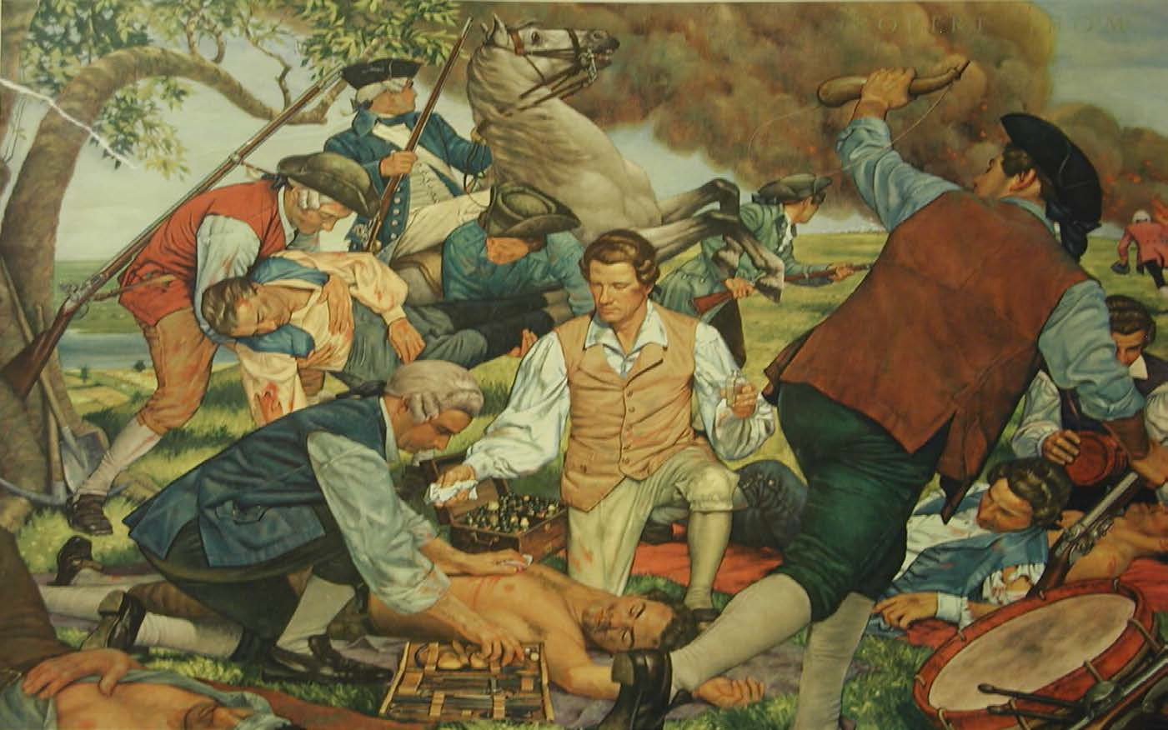
Andrew Craigie 1st Apothecary General (1775-1783) at the Battle of Bunker Hill
Notes:
Picture shows Craigie assisting the Dr. Townsend in treating patients at the Battle of Bunker Hill in Boston.
Craigie had many assistants to help compound and dispense medicines. They stocked the medicine chests which were carried in combat to treat wounded.
He created a warehouse in Carlisle, PA where dosage forms were prepared and where drugs were stored to supply the various pharmacies in Army hospitals.

Slide 12
Revolutionary War Era
Main concerns with military drug supply
  Drug shortages
  Market speculations
  Uncertain transport

Slide 13
Methods of Treatment and Drugs
Used During the Revolution
Antiseptic: Mercury (metals and salts)
Pain: Laudanum (a tincture of opium, saffron & Canary wine)
Laxative: Mercurous chloride (calomel), Glauber’s salt (sodium sulfate)
Syphilis: Larger doses of mercurous chloride
Malaria: Jesuits Bark (cinchona contains quinine)
Heart conditions: Digitalis
Bloodletting: Still used from Hippocratic times
Purging: Botanicals, emetics, jalap, ipecac, rhubarb
Amputation – 70% were fatal
There were no thermometers, stethoscopes, hypodermic syringes
Notes:
Symptoms of conditions were treated.
Hippocratic medicine still used
Botanicals for purging, emetics and laxatives still most in demand. Jalap, ipecac and rhubarb for purging, digitalis, and
Epsom salt (chemical)
Mercury(metals and salts) used for a variety of illness like syphilis and as antiseptic
Bloodletting

Slide 14
Drugs in the Medicine Chests
Calomel
Epsom salts
Peruvian bark (cinchona)
Tartar emetic
Opium or Paregoric Elixir
Jalap
Rhubarb
Glauber’s Salts
European and Local Herbs
Notes:
Contents of medicine chests varied, based on availability. May also include mortar and pestle.
Congressional Act of 1790 called for standardization in contents, however varied until 1876 when the Marine Hospital Service, which later became the U. S. Public Health Service, took on this task.

Slide 15
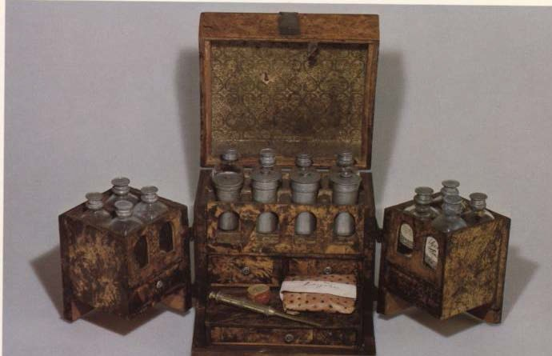
Medicine Chest early 1800’s

Slide 16
Where did the drugs come from?
Bought drugs from apothecaries
  Not enough for the growing military need
  British blockade, prices skyrocketed
  Marshall Apothecary*, Andrew Craigie’s warehouse
    Shipped chests of drugs to various army districts

Slide 17
Where did the drugs come from?
Loyalists indifferent to the cause
  Patriot pharmacies loyal to the cause faced losing everything
Loyalist Brits and their physicians poisoned supplies left behind as Continental Army moved in to Boston
  Mixed in arsenic
Notes:
Ships from Jamaica and Bermuda brought drugs to Philadelphia but Army was
very slow in buying these imported drugs
There was a shortage of drugs, especially cinchona for treating malaria
Some drugs were captured from the British

Slide 18
Where did the drugs come from?
Privateers captures British ships and drugs (best source)
  Captured over 1000 ships – prices went higher
Jamaica and Bermuda, brought drugs to Philadelphia
  Quality was scanty, other countries were unreliable
  Eventually supplied on a regular basis
Notes:
Ships from Jamaica and Bermuda brought drugs to Philadelphia but Army was
very slow in buying these imported drugs
There was a shortage of drugs, especially cinchona for treating malaria
Some drugs were captured from the British

Slide 19
Christopher Marshall and the Marshall Apothecary
1709-1707
Irish immigrant; trained in England
Opened apothecary shop in Philadelphia in 1729
  Remained open until 1825
Highly respected; apprentices wanted to train with him
Notes:
Mr. Marshall participated in social, civic and professional functions and instilled in his sons the importance of service to the community. Picture shows him inspiring his two young sons, Christopher Jr. and Charles, who later operated the Marshall Apothecary.
During the War of Independence Marshall sold drugs to the Colonial troops especially those soldiers stationed in PA, NJ, MD, VA and DELAWARE. He also helped take care of wounded soldiers in Philadelphia hospitals. Store sold in 1825.
ACCURACY, INTEGRITY, SKILL, RELIABILITY and ATTENTION TO PATIENTS, ACCOUNTED FOR HIS SUCCESS.
This philosophy became a lasting legacy in American pharmacy. It is believed that the dedication to patient well-being extends to us today due to the efforts of the Marshall family.

Slide 20
Christopher Marshall and the Marshall Apothecary
Sons Christopher Jr. (1740-1806) and Charles (1744-1825) were partners in the business
  Charles became first president of Philadelphia College of Pharmacy; his granddaughter Elizabeth became the first US female pharmacist
Notes:
Mr. Marshall participated in social, civic and professional functions and instilled in his sons the importance of service to the community. Picture shows him inspiring his two young sons, Christopher Jr. and Charles, who later operated the Marshall Apothecary.
During the War of Independence Marshall sold drugs to the Colonial troops especially those soldiers stationed in PA, NJ, MD, VA and DELAWARE. He also helped take care of wounded soldiers in Philadelphia hospitals. Store sold in 1825.
ACCURACY, INTEGRITY, SKILL, RELIABILITY and ATTENTION TO PATIENTS, ACCOUNTED FOR HIS SUCCESS.
This philosophy became a lasting legacy in American pharmacy. It is believed that the dedication to patient well-being extends to us today due to the efforts of the Marshall family.

Slide 21
Christopher Marshall and the Marshall Apothecary
Key role in the American Revolution
  Supplied medicine to George Washington’s troops
  Manufactured chemicals and medicine chests
Advertised with sign:
  “We fill prescriptions according to the wishes of your physician”
Notes:
Mr. Marshall participated in social, civic and professional functions and instilled in his sons the importance of service to the community. Picture shows him inspiring his two young sons, Christopher Jr. and Charles, who later operated the Marshall Apothecary.
During the War of Independence Marshall sold drugs to the Colonial troops especially those soldiers stationed in PA, NJ, MD, VA and DELAWARE. He also helped take care of wounded soldiers in Philadelphia hospitals. Store sold in 1825.
ACCURACY, INTEGRITY, SKILL, RELIABILITY and ATTENTION TO PATIENTS, ACCOUNTED FOR HIS SUCCESS.
This philosophy became a lasting legacy in American pharmacy. It is believed that the dedication to patient well-being extends to us today due to the efforts of the Marshall family.

Slide 22
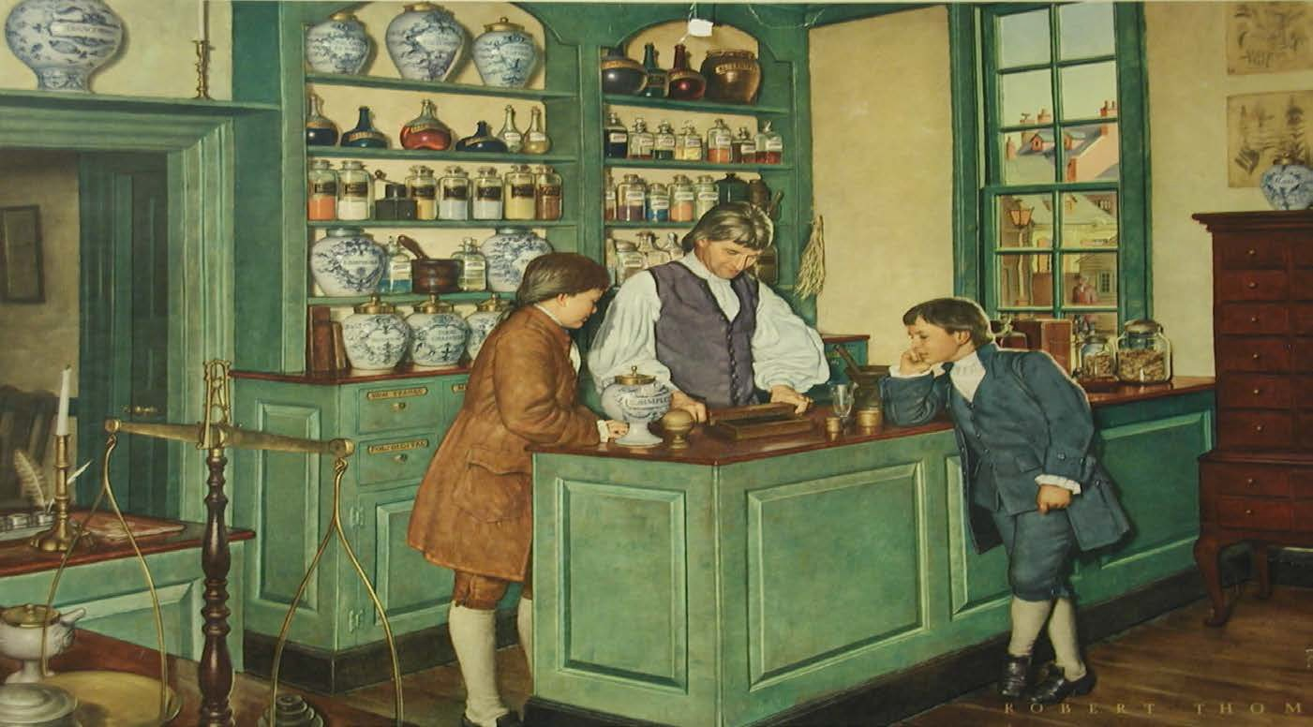
Marshall Apothecary 1729-1825
Christopher Marshall with sons, Christopher Jr. and Charles
Notes:
Mr. Marshall participated in social, civic and professional functions and instilled in his sons the importance of service to the community. Picture shows him inspiring his two young sons, Christopher Jr. and Charles, who later operated the Marshall Apothecary.
During the War of Independence Marshall sold drugs to the Colonial troops especially those soldiers stationed in PA, NJ, MD, VA and DELAWARE. He also helped take care of wounded soldiers in Philadelphia hospitals. Store sold in 1825.
ACCURACY, INTEGRITY, SKILL, RELIABILITY and ATTENTION TO PATIENTS, ACCOUNTED FOR HIS SUCCESS.
This philosophy became a lasting legacy in American pharmacy. It is believed that the dedication to patient well-being extends to us today due to the efforts of the Marshall family.

Slide 23
Revolutionary War Era
Lititz Pharmacopoeia
  Military formulary of 1778
  Small booklet
  Contained simple yet efficacious remedies
  Illustrates:
    Choice of items based on medical knowledge of the time (esp. British knowledge)
    Results of the American experience
    Difficulties arising from being a nation at war

Slide 24
Revolutionary War Era
Lititz Pharmacopoeia
  Because of the drug shortage
    Permitted official substitution of therapeutically equivalent substances for drugs in uncertain supply

Slide 25
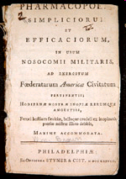
Lititz Pharmacopoeia
http://www.indiana.edu/~liblilly/etexts/medicine/images/thumbnails/rs141-2-b8_00001.jpg

Slide 26
Revolutionary War Era
Coste’s Compendium
  Compiled for French medical hospitals in America
  Jean-Francois Coste
    Chief physician to the French Army serving with the colonists

Slide 27
Revolutionary War Era
Importance of Revolution to Pharmacy
  8 years of separate but equal status as a profession apart from medicine
  First known large-scale manufacture of pharmaceuticals on American soil
  First practical attempt at a uniform formulary as a basis for satisfactory and reliable work

Slide 28
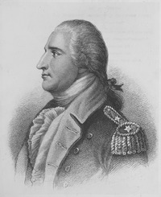
Benedict Arnold
c. 1741 – 1801
General during the American Revolution
  First for the American Continental Army
  Defected to the British after plot to surrender West Point exposed
  Name largely synonymous with treason in the United States

Slide 29
Benedict Arnold
But before all that…
  1762: pharmacist and bookseller in New Haven, CT
  Began trading in the West Indies
    Sister Hannah managed the apothecary in his absence
    Became smuggler by default by ignoring the Stamp Act

Slide 30
19th Century
Industrial Revolution accentuated diminution of the age old paradigm of the apothecary compounding individual prescriptions by hand

Slide 31
19th Century
Era of alkaloids and phytochemistry
  Roots of modern pharmaceutical chemistry
  Discovery of alkaloids such as morphine and quinine catalyzed the need for large scale production

Slide 32
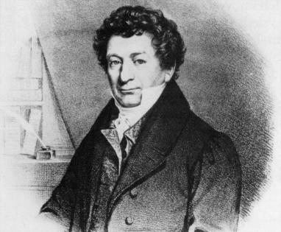
19th Century
Friedrich Wilhelm Adam Sertürner
  1783-1841
  German pharmacist
  First to isolate morphine from opium (1804)
    Published paper on its isolation, crystallization, crystal structure, and pharmacological properties (in stray dogs, then self-experiments)
Notes:
He called the isolated alkaloid "morphium" after the Greek god of dreams, Morpheus.
First alkaloid isolated from a plant

Slide 33
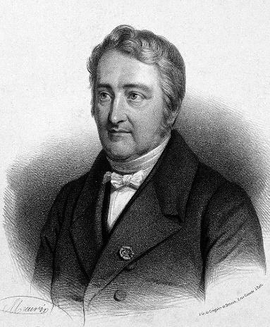
19th Century
1822: Pierre-Joseph Pelletier opened an industrial plant for quinine manufacturing in France
1823: Rosengarten & Sons produced and sold quinine in Philadelphia

Slide 34
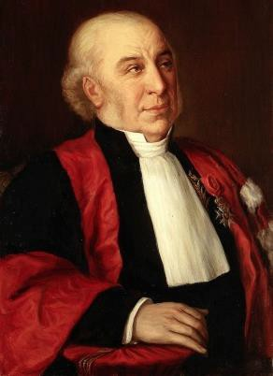
19th Century
Joseph Bienaimé Caventou
  1795-1877
  French pharmacist and professor
  Collaborated with Pelletier
  Pioneer in the use of mild solvents to isolate a number of active ingredients from plants, particularly alkaloids
Notes:
He called the isolated alkaloid "morphium" after the Greek god of dreams, Morpheus.
First alkaloid isolated from a plant

Slide 35
Most Modern Pharmaceutical Companies Have Roots in the 19th Century
Pharmaceutical Company | Year of Foundation
H.E. Merck, Germany | 1827
Pfizer | 1849
E.R. Squibb & Sons, US | 1858
Wyeth, US | 1860
Bayer AG, Germany | 1863
Burroughs, Wellcome & Company, England | 1880
Eli Lily, US | 1876
Johnson & Johnson, US | 1885
Bristol-Myers, US | 1887
Abott Laboratories, US | 1888
Merck & Companies, US | 1891
F. Hoffmann-La Roche AG, Switzerland | 1896

Slide 36
19th Century
HE Merck
  1827
  Began manufacturing and selling various alkaloids in Germany
  Later opened a pharmaceutical plant in the US in 1891
Notes:
He called the isolated alkaloid "morphium" after the Greek god of dreams, Morpheus.
First alkaloid isolated from a plant

Slide 37
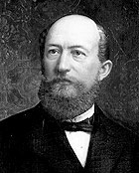
19th Century
Friedrich Bayer
  1825-1880
  1863: Founded Bayer AG in Germany
    Began as a dyestuff factory

Slide 38
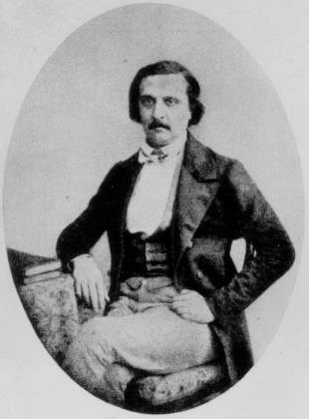
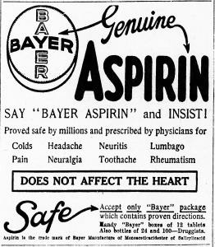
19th Century
  1897: Bayer chemists synthesized pure acetyl salicylic acid
    Had previously been synthesized in an impure form by French chemist Frédéric Gerhardt (1816-1856)
  1899: filed aspirin trademark worldwide
Notes:
He called the isolated alkaloid "morphium" after the Greek god of dreams, Morpheus.
First alkaloid isolated from a plant

Slide 39
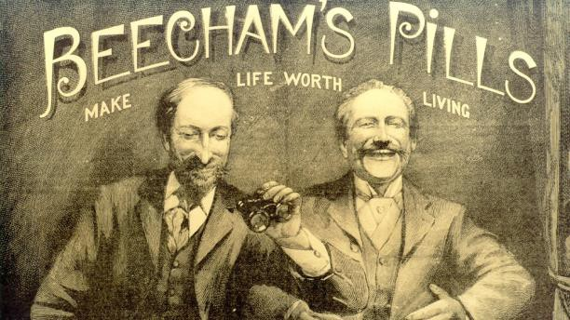
19th Century
Thomas Beecham
  1820-1907
  1842: marketed Beecham’s Pills (laxative)
    Contained aloe, ginger and soap with some minor ingredients
  1859: Beecham’s opened first factory for rapid production in Lancashire, England
    Mergers → SmithKline Beecham → GlaxoSmithKline

Slide 40
Philadelphia: Birthplace of American Pharmaceutical Industry
1823: Rosengarten & Sons produced and sold quinine in Philadelphia
  Also produced morphine salts and other alkaloids
1826: Samuel Wetherill began manufacturing various chemicals and alkaloids
Notes:
The city of Philadelphia became the birthplace of American pharmaceutical manufacturing and pharmacy after the American revolution

Slide 41
Philadelphia: Birthplace of American Pharmaceutical Industry
1841: John K. Smith established a pharmaceutical factory with his accountant, Mahlon Kline
1856: William Warner invented and began manufacturing the sugar-coated pill
Notes:
The city of Philadelphia became the birthplace of American pharmaceutical manufacturing and pharmacy after the American revolution

Slide 42
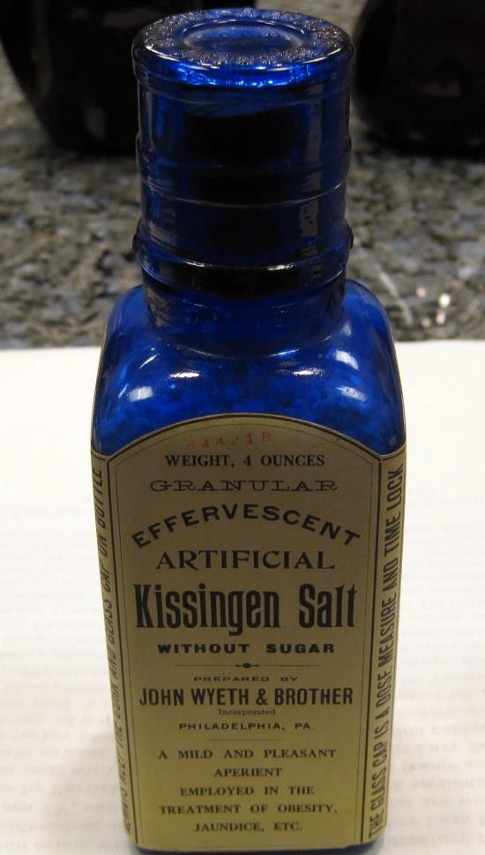
Philadelphia: Birthplace of American Pharmaceutical Industry
1860: John (1834–1907) and Frank Wyeth found Wyeth and Brother
  1872: Henry Bowers developed first rotary compressed tablet machine in US
  Name changes over time: American Home Products → Wyeth → acquired by Pfizer in 2009
.
Notes:
The city of Philadelphia became the birthplace of American pharmaceutical manufacturing and pharmacy after the American revolution

Slide 43
Expansion of US Pharmaceutical Industry in the 19th Century
1849: Pfizer founded in New York City
  Charles Pfizer and Charles F. Erhart
  First product: palatable form of santonin (antiparasitic)
Notes:
Erhart was Pfizer’s cousin

Slide 44
Expansion of US Pharmaceutical Industry in the 19th Century
1855: Frederick Stearns and Company established in Detroit
  Specialized in fluid extracts
  Stated listing the names of the ingredients in the preparations before it was required by the Pure Food and Drug Act of 1906
Notes:
Erhart was Pfizer’s cousin

Slide 45
The Role of War on the Pharmaceutical Industry
Accentuated need for mass production of good-quality pharmaceuticals
1846-1848: Mexican American War
  Resulted in significantly higher casualties off the battlefield
    In part caused by import of fake or adulterated drugs
    Led to passage of first pharmaceutical regulation, the 1848 Drug Import Law
.
Notes:
https://www.cbp.gov/sites/default/files/documents/mexicanamericanwar.pdf

Slide 46
Expansion of US Pharmaceutical Industry in the 19th Century
1858: Squibb founded in Brooklyn, NY by Edward R. Squibb
  Enlisted as a navy doctor during the Mexican American War
  Frustrated by poor drug quality and spent career working to combat adulteration
Notes:
Which leads directly to next topic….

Slide 47
The Age of Quackery
Compounded products you won’t see prescribed today
Blue mass pills
  Staple in 1850’s for melancholy
  Contained:
    Mercury (375 mcg)
      Safe daily dose = 21 mcg
    Honey
    Rose water
    Licorice root
    Rose petals

Slide 48
The Age of Quackery
Compounded products you won’t see prescribed today
Blue mass pills
  Known to be taken by Abraham Lincoln
  Probably explain outbursts of rage and bizarre behavior
    Lincoln-Douglas debate, 1858
    Shook Orlando Ficklin and lifted him out of his seat
    Realized it was the pills; never took them again

Slide 49
Age of Quackery
Patent Medicines
Age of quackery
  1880s:
    Very popular sales items
    Ingredients kept secret until 1906 Federal legislation
    Few were actually patented
    Claims were often sensational and exaggerated
    Sometimes effective, but often dangerous

Slide 50
Age of Quackery
Patent Medicines
Many of these drugs developed out of the custom of pharmacists producing and marketing their own remedies
  Largely vegetable drugs

Slide 51
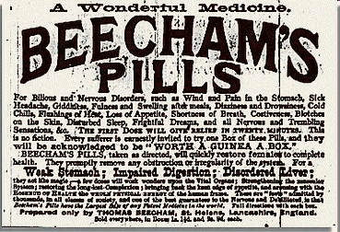

Slide 52
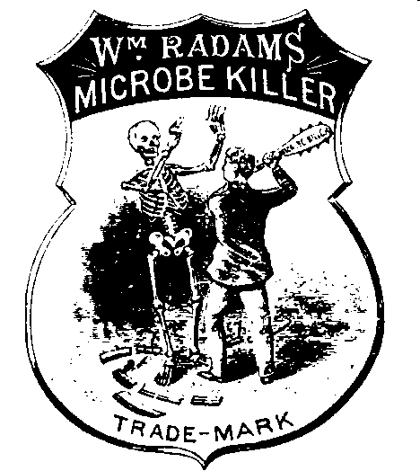

Slide 53
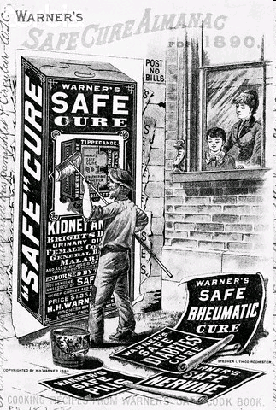

Slide 54
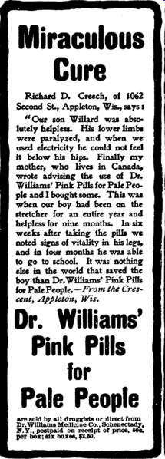
Contained iron oxide and magnesium sulfate

Slide 55
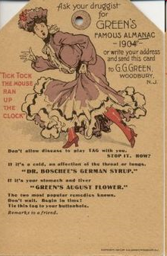
Mostly laudanum

Slide 56
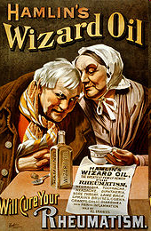
Liniment for rheumatic pain
Also advertised for:
  pneumonia, cancer, diphtheria, earache, toothache, headache and hydrophobia
Contained:
  50-70% alcohol
  Camphor
  Ammonia
  Chloroform
  Sassafras
  Cloves
  Turpentine
Could taken internally or used topically

Slide 57
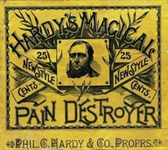
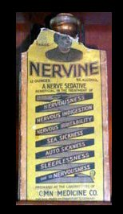
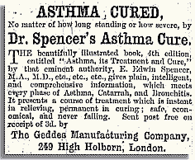

Slide 58
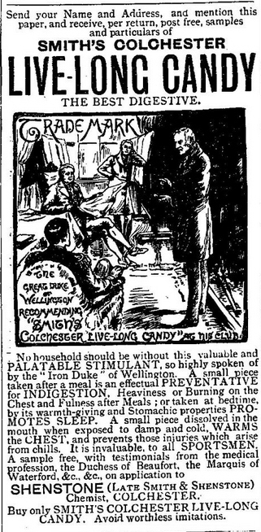
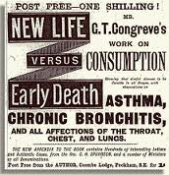

Slide 59
Civilian Pharmacy during the Civil War Period
Most crude drugs were imported
  Sold to wholesalers or large drug companies
  Finished medicines were distributed to retail pharmacists and physicians for sale to the public

Slide 60
Civilian Pharmacy during the Civil War Period
Challenges:
  Volatile prices due to speculators
  Drug adulteration
  Lack of formal pharmacy education
  Most crude drug was imported to the Northern states – problem for those living in the Confederacy

Slide 61
Military Pharmacy during the Civil War Period
4 major stages of drug supply during the war, all of which involved pharmacists:
  Acquisition of materials
  Inspection and preparation of finished medicines
  Distribution to depots and hospitals
  Dispensing to patients

Slide 62
Military Pharmacy during the Civil War Period
Pre-war:
  US Army bought medicine on the open market
  Distributed through a large depot in New York, plus some smaller depots

Slide 63
Military Pharmacy during the Civil War Period
During war (in the North):
  Expanded to 30 depots
    Major centers in New York and Philadelphia
    Relied heavily on handful of domestic drug companies for stable inventories and prices
  In field, medical purveyors:
    Requisitioned medicines
    Distributed to units

Slide 64
Military Pharmacy during the Civil War Period
During war (in the South):
  Acquisition hampered by blockade
  Southern drugstore stock was quickly used up
  What to do?
    Blockade running
    Smuggling through enemy lines
    Capture of Union supplies
    Use of native plants and remedies

Slide 65
Military Pharmacy during the Civil War Period
Both sides established laboratories to:
  Inspect raw drug material
  Prepare finished medicines
  Union labs:
    Philadelphia, Long Island, Brooklyn, St. Louis
  Confederate labs:
    Richmond, plus labs in Alabama, Georgia, North and South Carolina, Arkansas, and Texas

Slide 66
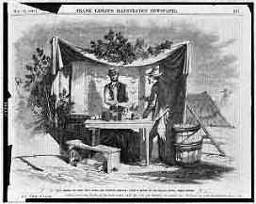
Battlefield Drugstore
http://www.drugstoremuseum.com/images/level_imgs/65498419851.jpg

Slide 67
Need for Standards
Patent medicines and adulterated drugs during the Civil War contributed greatly to the need for standards

Slide 68
Charles Rice
1841-1901
  Received compounding training in the Navy
  Subsequently began work at Bellevue Hospital in NYC
    Lived there most of his life
  Outspoken about need for compounding and dispensing standards
    Creator of modern day pharmacopeia
    Also instrumental in creating National Formulary
    USP/NF (unified in 1975) is the official compendium of drug standards in the US

Slide 69
United States Pharmacopeia
Designed to bring uniformity to the materia medica and pharmacy preparations of the day
  First published in 1820
  Initial work (first and second revisions) was done by physicians
  USP Convention in 1840 involved pharmacists as well
  Physicians lost interest by 1870

Slide 70
United States Pharmacopeia
First Edition – what sort of formulas did it contain?
Notes:
In salves for analgesic properties

Slide 71
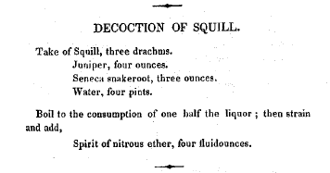
Notes:
The Medicinal Squill was valued as a medicine in early classic times and has ever since been employed by physicians, being official in all pharmacopoeias. Oxymel of Squill, used for coughs, was invented by Pythagoras, who lived in the sixth century before Christ. Probably the sea onion mentioned by Homer. Diuretic, expectorant, and stimulating properties.
Juniper is used for digestion problems including upset stomach, intestinal gas (flatulence), heartburn, bloating, and loss of appetite, as well as gastrointestinal (GI) infections and intestinal worms. It is also used for urinary tract infections (UTIs) and kidney and bladder stones. Other uses include treating snakebite, diabetes, and cancer.
Some people apply juniper directly to the skin for wounds and for pain in joints and muscles. The essential oil of juniper is inhaled to treat bronchitis and numb pain.
Seneca snakeroot was utilized by the Seneca Indians in treatment of rattlesnake bite. Canadian botanist Frère Marie-Victorin suggested that the resemblance of the knotty root crown to a rattlesnake's tail may have contributed to its use by the Seneca as an antidote.
Its use, however, was not confined to the Seneca, for it was considered to have several medicinal properties, especially in relation to respiratory ailments, among other tribes including Ojibwa, Huron, Menomini and Iroquois. Walpole Island Ojibwa of southern Ontario used the root for headache, nasal congestion and stomach ache. It was utilized as a general cure by the Ojibwa Indians and carried by them on their journeys for general health and safety.
Seneca snakeroot was sent to Europe in the early 1700s and held a regular place in European drug stores during the 1800s for use in treatment of pneumonia.
The root is ground into powder and used in various patent medicines, particularly in cough medicines, as a stimulant expectorant. It is present in some prescription drugs used in the treatment of bronchitis and asthma. Seneca snakeroot is also used in veterinary medicine. Aside from its effects on the respiratory system, it promotes perspiration and urination.

Slide 72
Notes:
Medicinal Use
Indians used tobacco as a pain reliever for ear aches, toothaches and as a poultice. The leaves of N. attenuata variety were mainly used for the medical purposes. In fact, currently there are test studies being performed to find a way to extract the pain relieving components of tobacco and remove the addictive ones to use for medical purposes. (Source) *No one in the medical profession will allow nicotine to be a treatment for medical issues or mental illnesses because of the health risks. But they are studying the benefits of tobacco nonetheless.
To make a poultice, crush the leaves to place on the affected area to relieve medical issues.
Skin Rashes, Eczema and rheumatism - Indians used a poultice of tobacco leaves to put on skin inflammations to help soothe and relieve pain. Although there is documented accounts that tobacco has pain relieving qualities, this author could not find any information on how tobacco soothed skin inflammation.
Toothaches – This poultice could also be placed in the mouth to alleviate pain from toothaches.
Rattlesnake and Insect Bites - Indians believed that the nicotine in the tobacco would help relieve pain as well as help draw out the poison and heal the snake wound. After the poison had been sucked out, chewed leaves could be applied to cuts or bound on the bite with a bandage. This method can also be used when stung by an insect.
Colds - Indians would mix tobacco and leaves from the Desert Sage plant, or the root of Indian Balsam (or cough root), Leptotaenia Multifida. They believed this would also help with asthma and tuberculosis. They typically smoked the leaves to clear out nasal passages.
Toothpaste - In India, powdered tobacco is rubbed on the teeth for cleaning. This method is still used in India and marketed in stores around the country.

Slide 74
Notes:
Both are laxatives

Slide 76

Edward Robinson Squibb
1819-1900
  Advocate of product standards
    Quality more important than lowest price
    Ether – steam process of production led to more standardized, efficacious product
      Refused to patent process
      Published for others to use

Slide 77
Edward Robinson Squibb
  Went on to form pharmaceutical company in 1858
    Initial lab was destroyed by fire when a lab assistant dropped a bottle of ether
    Rebuilt; lab assistant was retained (and promoted!)
    Saw tremendous growth
      Sold ether with excellent reputation for quality
      Civil War increased demand for products

Slide 78
Edward Robinson Squibb
  Post-war: increased attention on substandard and adulterated medicines
  1876 APhA meeting: led debate on the future of the USP
    Need for more frequent revision
    Increased discussion of monographs
    Correction of errors
  1877 APhA meeting:
    Formed Committee on Revision
    Charles Rice named as chair

Slide 79
Charles Rice
1841-1901
  Creator of the modern pharmacopeia
    6th Revision was very different from previous editions
    Provided a useful tool for pharmacists who were abandoning in-store manufacturing and focusing on quality and standards
  Father of the National Formulary

Slide 80
United States Pharmacopeia
Changes implemented with Rice at helm:
  List of guiding principles - 1880
    Use of English weights and measures (rather than English and Latin)
    Parts by weight
    Use of a single alphabetic list
    Chemical formulas, specific gravities, and atomic weights were to be added
    USP VI was to “address the needs of professional practice, mass manufacturing, and developing regulations against drug adulteration”

Slide 81
National Formulary
Pharmacists were becoming concerned with rapid growth of manufacturers in the mid-1880s
  Didn’t want to merely “count and pour”
  Wanted lists of formulas that physicians could prescribe and pharmacists could compound
Rice served as chair of Committee on Unofficial Formulas of the APhA
  New York and Brooklyn Formulary was starting point
  Eventually resulted in NF
  Only involved in first edition

Slide 82
The Era of Biologicals
1866: Parke Davis and Company established in Detroit
  Standardized botanical extracts
  First to establish its research institute in 1902

Slide 83
The Era of Biologicals
1876: Eli Lilly & Company established in Indianapolis
  Eli Lilly was a Union artillery colonel
  Produced standardized botanical extracts
  Began commercial manufacture of insulin worldwide in 20th century

Slide 84
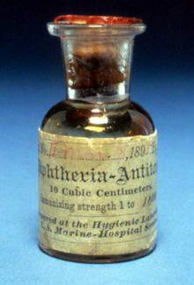
The Era of Biologicals
1894: HK Mulford Company established in Philadelphia
  Produced anti-toxins
  By 1900: produced dozens, including rabies, tetanus, anti-streptococcus
  Along with Parke Davis, received first licenses to produce

Slide 85
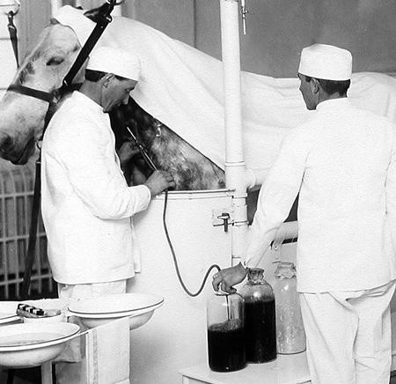
The Era of Biologicals
1901: 13 children in St. Louis die of tetanus following administration of contaminated diphtheria anti-toxin
  Leads to Biologics Control Act of 1902, designed to regulate serums and vaccines

Slide 86
War Changes Everything
Prior to World War I (1914-1918), the US pharmaceutical industry relied heavily on German scientific research
  Most of the German pharmaceuticals sold in the US were manufactured in American plants under licensing agreements and protected by US patents

Slide 87
War Changes Everything
Bayer’s US assets were seized during WWI
  1918: Sterling Products, Inc. acquired Bayer Company Incorporated of New York for $5.5 millions
    Sales of Bayer’s aspirin in US was $600 million in 1970 alone
    Bayer reacquired rights for aspirin in 1994 for $1 billion

Slide 88
War Changes Everything
Merck and Co. was confiscated following WWI
  Set up as an independent company in the US
Many US pharmaceutical companies set up their own research at this point

Slide 89
The Era of Insulin and Penicillin
1921: insulin discovered by Frederick Banting and Charles Best (Univ. Toronto)
1922: Eli Lilly and Univ. Toronto researchers worked together to develop large scale production of insulin
1923: Lilly begins selling Iletin® (insulin), first commercially available insulin for treatment of diabetes

Slide 90
The Era of Insulin and Penicillin
1928: penicillin discovered by Alexander Fleming
WWII: War Production Board oversees mass production of penicillin by numerous companies: Merck, Pfizer, Abbott, Squibb, Lilly, Parke Davis, Upjohn, Lederle, Reichel Laboratories, and Heyden Chemical
  Paradigm shift in capabilities of US pharmaceutical industry

Slide 91
The Rise of the Pharmaceutical Industry Post-WWII
US pharmaceutical industry flourished after WWII
  Knowledge of large scale penicillin production catalyzed further discovery of antibiotics
    1945: Streptomycin (Merck)
    1948: Chlortetracycline (Lederle)
    1949: Chloramphenicol (Parke Davis)
    1950: Oxytetracycline (Pfizer)
    1952: Erythromycin (Lilly)

Slide 92
The Rise of the Pharmaceutical Industry Post-WWII
Other therapeutic areas
    Antihistamines (Benadryl, Parke Davis, 1946)
    Tranquilizers
    Antidepressants
    Proton pump inhibitors
    Anti-hypertensives
    Anti-hyperlipidemics

Slide 93
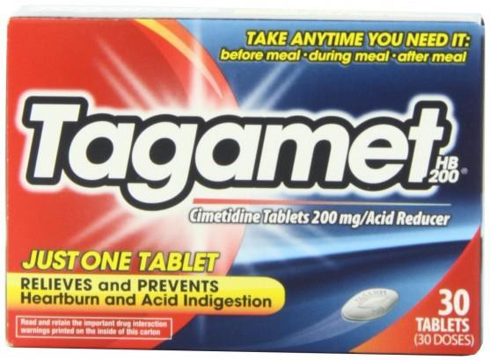
The Era of Block Buster Drugs
1977: Tagamet (cimetidine)
  Smith, Kline and French
  Anti-ulcer medication
  First ever “block buster” drug
  Earning > $1 billion per year
  Nobel Prize: Sir James Black

Slide 94
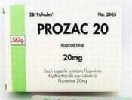
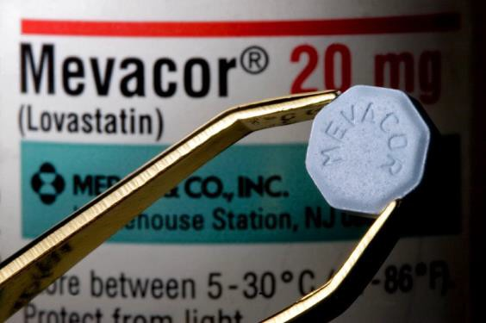
The Era of Block Buster Drugs
Competition to develop next “block buster”
  1987: Prozac (fluoxetine)
    Eli Lilly
    First SSRI
    Revolutionized mental health field
  1987: Mevacor (lovastatin)
    Merck
    First statin (HMG CoA reductase inhibitor)

Slide 95
Lipitor®: the best selling drug in the history of pharmaceuticals
1985: atorvastatin first synthesized
  Team led by Bruce Roth at Warner-Lambert’s Parke Davis research facility
    Roth fought to get drug into trials, were it outperformed simvastatin on safety/efficacy
    1996: Warner-Lambert and Pfizer entered into co-marketing agreement
    2000: Pfizer acquired Warner-Lambert
    Flagship drug for years; > US$125 billion in sales over ~14.5 years

Slide 96
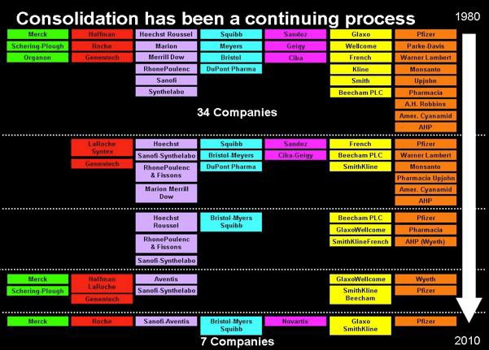
The Era of Mergers and Acquisitions

Slide 97
The Rise of the Generic Drug Industry
Drug Price Competition Act of 1984
AKA Hatch-Waxman Act
  Amended the Federal Food, Drug and Cosmetic Act (FDCA) and the Patent Act
  Established an abbreviated new drug application (ANDA) process requiring only bioequivalence studies
    Provided for filing of generic drug applications 60 days later

Slide 98
Drug Price Competition Act of 1984
AKA Hatch-Waxman Act
  Created modern US generic drug industry
    Generic drugs now account for a major portion of the prescriptions in the US
    Worldwide sales of generic drugs is > $80 billion

Slide 99
The Era of Biologics
Biotech Industry
Many biotech companies were founded in late 20th Century that focused on development of biotechnology based medicine
  1976: Genentech
  1978: Biogen
  1980: Amgen
  1981: Immunex

Slide 100
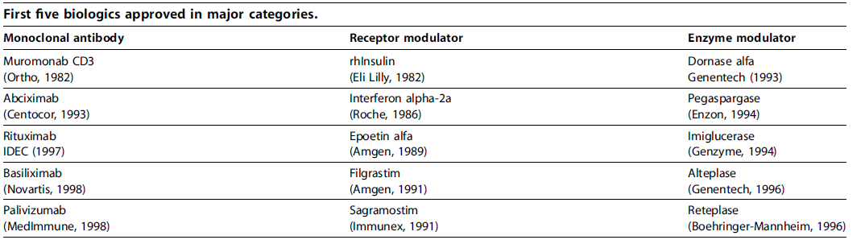
The Era of Biologics

Slide 101
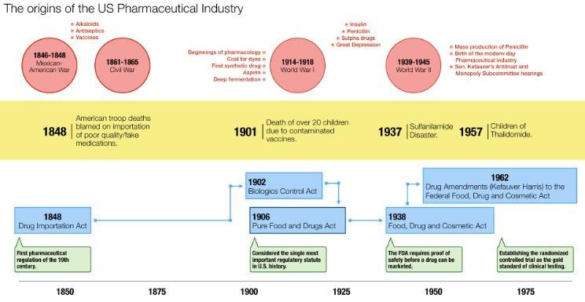
https://www.linkedin.com/pulse/creation-crisis-consequence-brief-history-early-us-industry- rahman
30

Slide 102
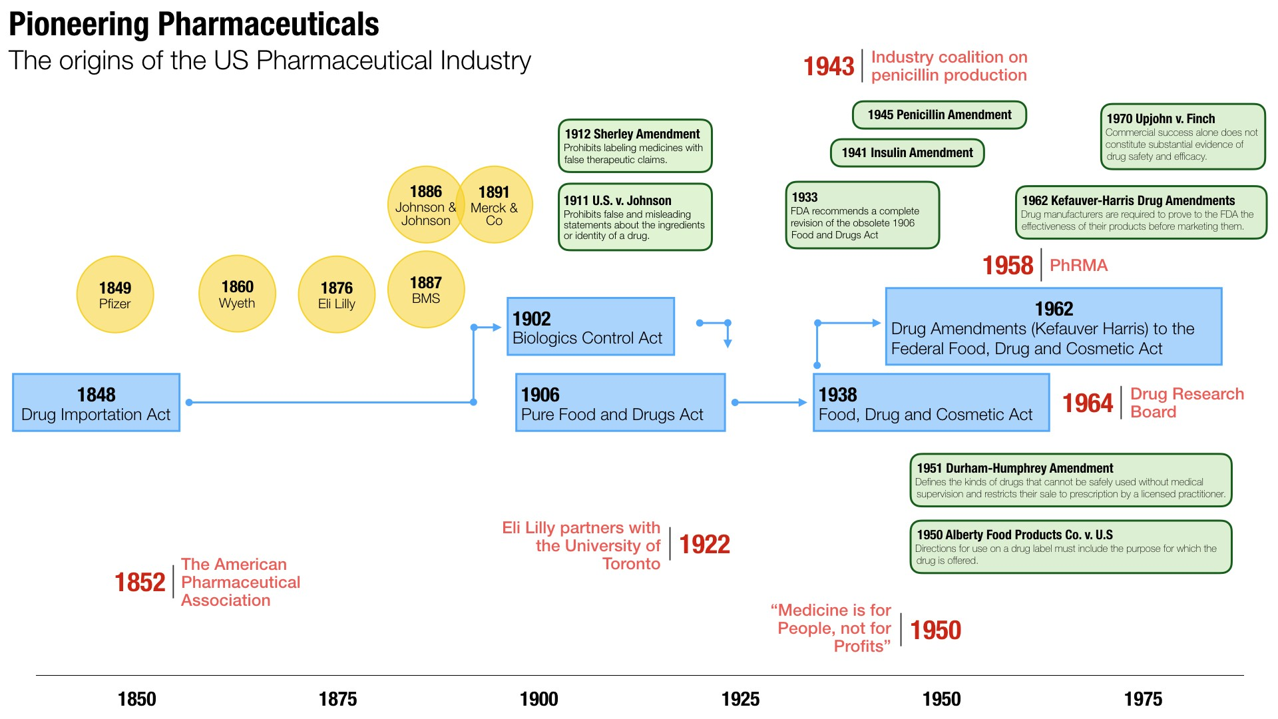
https://www.linkedin.com/pulse/creation-crisis-consequence-brief-history-early-us-industry-
rahman
31

